Slide 1
Database architecture

Slide 2
Storage Management Component
Storage manager is a program module that provides the interface between the low-level data stored in the database and the application programs and queries submitted to the system.
The storage manager is responsible to the following tasks:
Interaction with the file manager
Efficient storing, retrieving and updating of data
Storage Manager implements the following data structures:
Data Files: stores database itself
Data Dictionary: stores metadata about the structure of the DB
Indices: for fast access
Issues:
Storage access
File organization
Indexing and hashing
Notes:
2

Slide 3
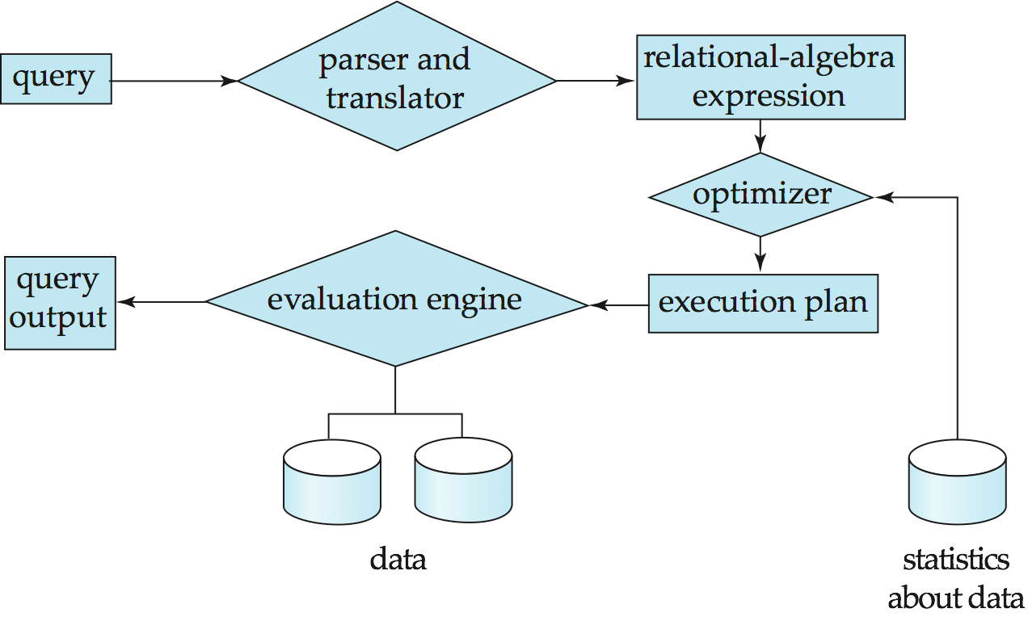
Query Processing Component
1. Parsing and translation
2. Optimization
3. Evaluation
Consist of: DDL Interpreter and DML Compiler
Notes:
3

Slide 4
Query Processing (Cont.)
Alternative ways of evaluating a given query
Equivalent expressions
Different algorithms for each operation
Cost difference between a good and a bad way of evaluating a query can be enormous
Need to estimate the cost of operations
Depends critically on statistical information about relations which the database must maintain
Need to estimate statistics for intermediate results to compute cost of complex expressions
Notes:
4

Slide 5
Transaction Management
What if the system fails?
What if more than one user is concurrently updating the same data?
A transaction is a collection of operations that performs a single logical function in a database application
Transaction-management component ensures that the database remains in a consistent (correct) state despite system failures (e.g., power failures and operating system crashes) and transaction failures.
Concurrency-control manager controls the interaction among the concurrent transactions, to ensure the consistency of the database.
Atomicity - all-or-none
Notes:
5

Slide 6
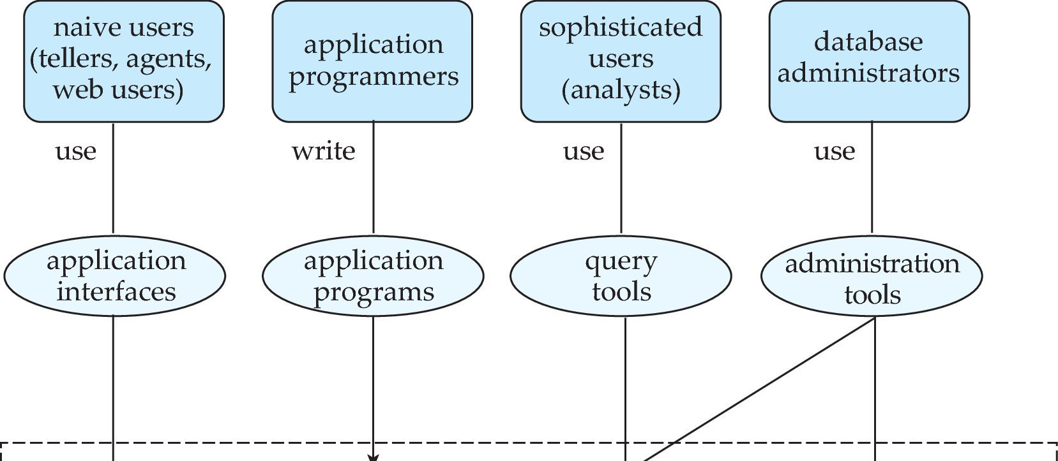
Database Users and Administrators
Database
Notes:
6

Slide 7
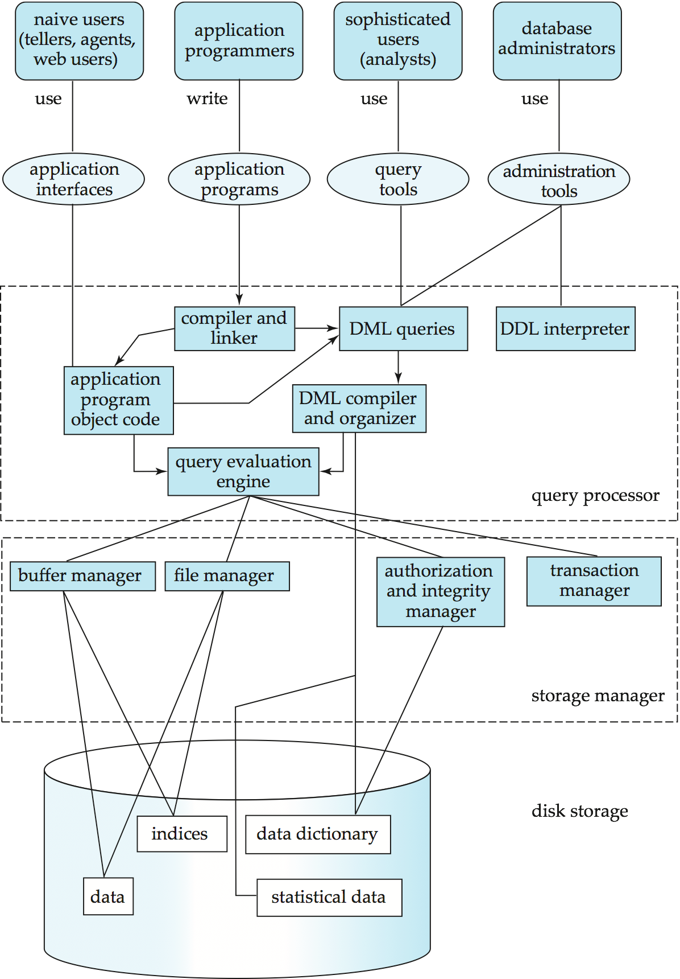
Database System Internals
Notes:
7

Slide 8
Database Architecture
The architecture of a database systems is greatly influenced by
the underlying computer system on which the database is running:
Centralized
Client-server
Parallel (multi-processor)
Distributed
Notes:
8

Slide 9
History of Database Systems
1950s and early 1960s:
Data processing using magnetic tapes for storage
Tapes provided only sequential access
Punched cards for input
Late 1960s and 1970s:
Hard disks allowed direct access to data
Network and hierarchical data models in widespread use
Ted Codd defines the relational data model
Would win the ACM Turing Award for this work
IBM Research begins System R prototype
UC Berkeley begins Ingres prototype
High-performance (for the era) transaction processing
Notes:
9

Slide 10
History (cont.)
1980s:
Research relational prototypes evolve into commercial systems
SQL becomes industrial standard
Parallel and distributed database systems
Object-oriented database systems
1990s:
Large decision support and data-mining applications
Large multi-terabyte data warehouses
Emergence of Web commerce
Early 2000s:
XML and XQuery standards
Automated database administration
Later 2000s:
Giant data storage systems
Google BigTable, Yahoo PNuts, Amazon, ..
Notes:
10

